Slide 1
Going to
Gold II - Unit 4

Slide 2
Using “going to”
We use “going to” to talk about our plans for the future.
If we are talking in the positive, we make a sentence as shown below:
For example:
I am going to play tennis.
I | am | Going to | Verb (infinitive)
She / He / It | is
You / We / They | are

Slide 3
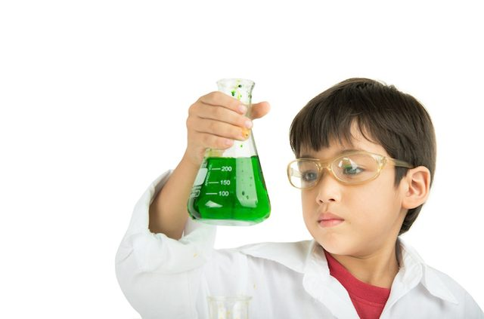
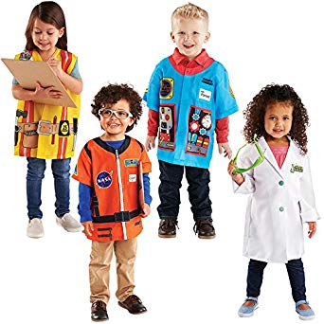
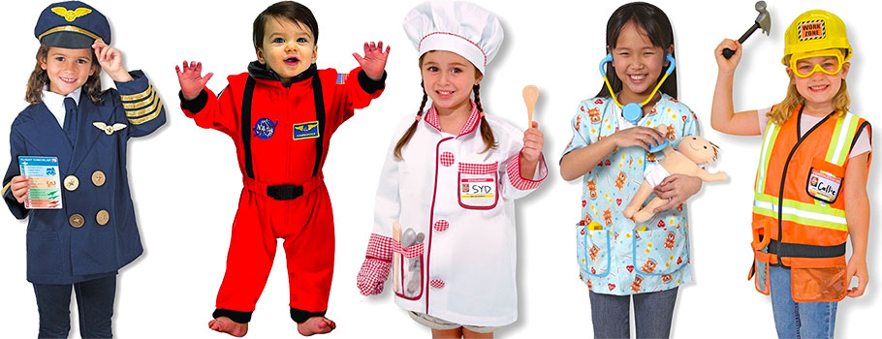
Look at the pictures and say what they are “going to” do in the future

Slide 4
If we are talking in the negative, we make a sentence as shown below:
Look at the pictures again, what are they not “going to” do?
For example: She’s not going to be an architect.
I | Am not / ‘m not | Going to | Verb (infinitive)
She / He / It | Isn’t / ‘s not
You / We / They | Aren’t / ‘re not

Slide 5

Look at the positive table again...
I | am | Going to | Verb (infinitive)
She / He / It | is
You / We / They | are
To make a question we switch the first two columns…
Am | I | Going to | Verb (infinitive)
Is | She / He / It
Are | You / We / They
Don’t forget the question mark!

Slide 6
We can put question words before to find out more information:
Where - a place
Who - a person
What - an object or thing
When - a time
Why - because
How - a method
How many - a number
How much - a price

Slide 7
Grammar practice
Work in pairs or small groups.
Ask each other questions using “going to”.
Remember, the questions are about the future.
For example:
What are you going to do at the weekend?
When are you going to finish your homework?
Who are you going to see next week?
Where are you going to go on holiday this year?

